Slide 1
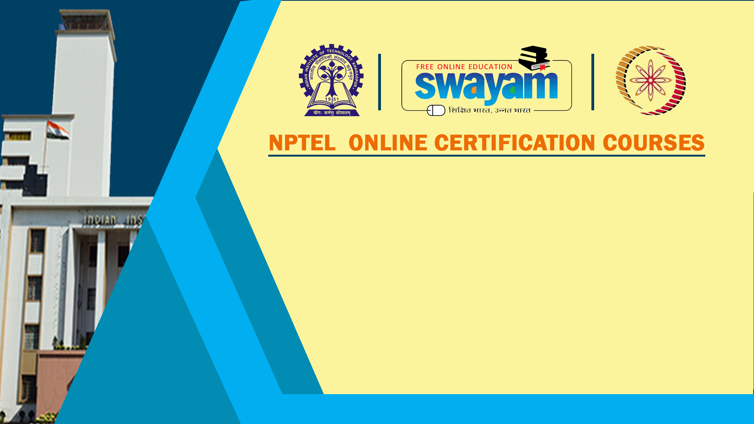
Course Name: Hardware Security
Faculty Name: Prof Debdeep Mukhopadhyay
Department : Computer Science and Engineering
Topic
Lecture 09: Advanced Encryption Standard (AES) and Cryptanalysis

Slide 2

Concepts Covered:
AES: Advanced Encryption Standard
Definitions of Round Operations of AES
GF(2) Algebra: Modular Arithmetic in characteristic 2
Implementation of Ciphers: Challenges

Slide 3
Binary Finite Fields
A finite field defines a finite set S and two commutative operations ( ∙ , + ) in which
Two elements can be added, subtracted, multiplied
Any element can be divided by a non-zero element
Multiplication distributes over addition
Binary Finite Fields: The set S consists polynomials with coefficients in {0,1}
Also known as Galois field
Represented as GF(2^{m}), where 2^{m} is the number of elements in S
AES is constructed using binary finite fields

Slide 4
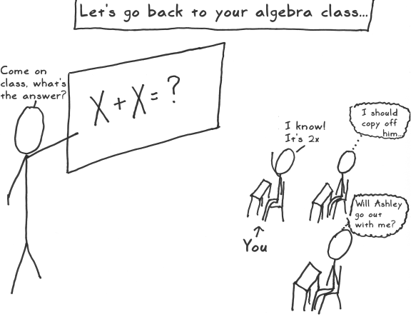

Slide 5
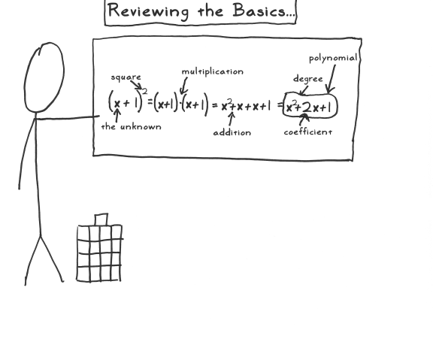

Slide 6
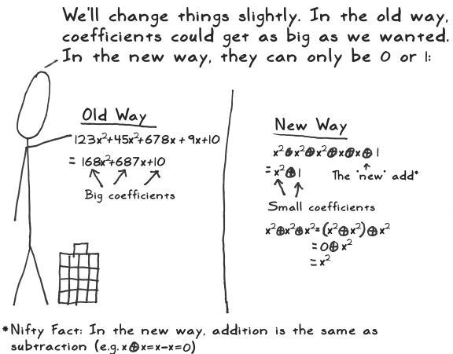

Slide 7
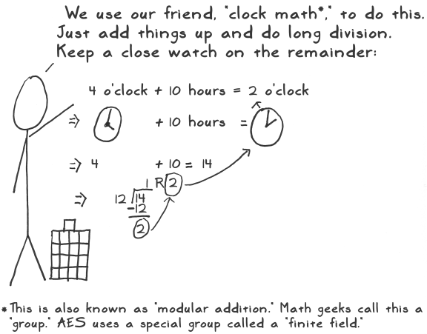

Slide 8
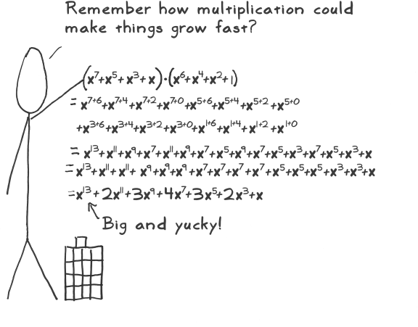

Slide 9
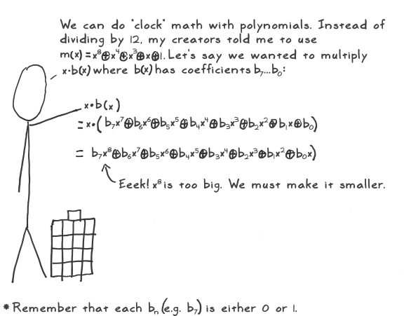
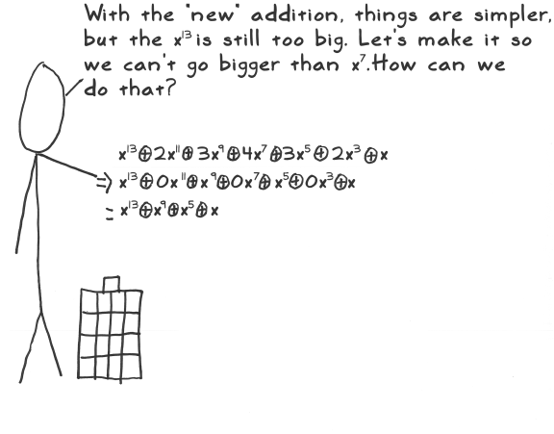

Slide 10
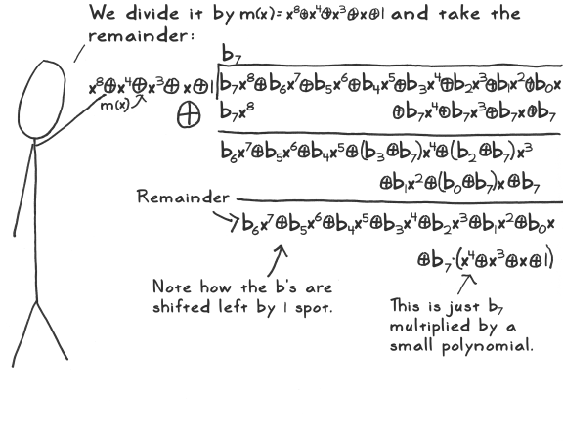

Slide 11
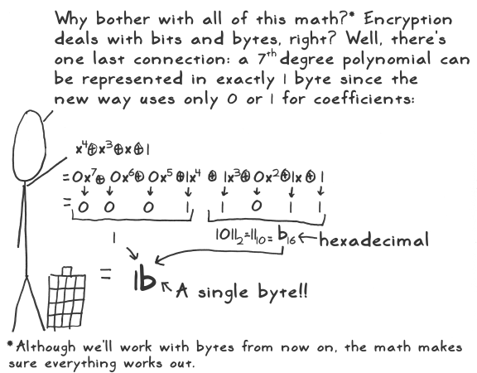

Slide 12
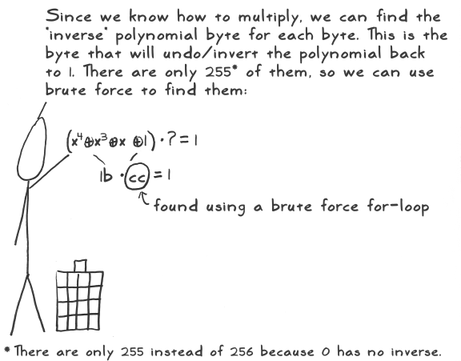

Slide 13
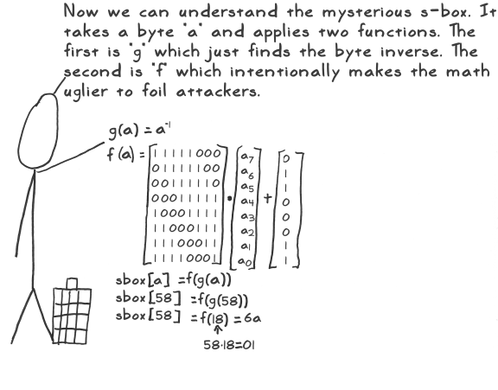

Slide 14
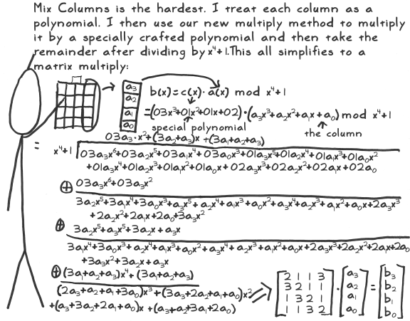

Slide 15
Add Round Key
a
e
i
m
k₀
k₄
k₈
k₁₂
a +k₀
e+k₄
i+k₈
m+k₁₂
b
f
j
n
k₁
k₅
k₉
k₁₃
b+k₁
f+k₅
j+k₉
n+k₁₃
c
g
k
o
k₂
k₆
k₁₀
k₁₄
c+k₂
g+k₆
k+k₁₀
o+k₁₄
d
h
l
p
k₃
k₇
k₁₁
k₁₅
d+k₃
h+k₇
l+k₁₁
p+k₁₅

Slide 16
Shift Rows
a
a
b
f
c
k
a
e
i
m
a
e
i
m
d
p
b
f
j
n
f
j
n
b
e
e
c
g
k
o
k
o
c
g
f
j
d
h
l
p
p
d
h
l
g
o
h
d
ShiftRows
Leave the First row untouched
Left Rotate (2nd Row by 8 bits)
Left Rotate (3rd Row by 16 bits)
Left Rotate (4th Row by 24 bits)
Implementation in Hardware
No resources required, only mapping with wires
i
i
j
n
k
c
l
h
m
m
n
b
o
g
p
l

Slide 17
Inverse Shift Rows
a
a
f
b
k
c
a
e
i
m
a
e
i
m
p
d
f
j
n
b
b
f
j
n
e
e
k
o
c
g
c
g
k
o
j
f
p
d
h
l
d
h
l
p
o
g
d
h
ShiftRows
Leave the First row untouched
Right Rotate (2nd Row by 8 bits)
Right Rotate (3rd Row by 16 bits)
Right Rotate (4th Row by 24 bits)
i
i
n
j
c
k
h
l
m
m
b
n
g
o
l
p

Slide 18
Mix Columns
a
e
i
m
A
E
E
I
M
b
j
n
B
F
J
N
f
F
c
k
o
C
G
K
O
g
G
d
l
p
D
H
L
P
h
H
The 4x4 matrix is multiplied with the matrix

Slide 19
Inverse Mix Column
a
e
i
m
A
E
E
I
M
b
j
n
B
F
J
N
f
F
c
k
o
C
G
K
O
g
G
d
l
p
D
H
L
P
h
H
The 4x4 matrix is multiplied with the matrix
The hardware implementation can be done in a similar way as mix columns

Slide 20
Byte Substitution
Makes a non-linear substitution for every byte in the 4x4 matrix
Sbox
a
e
i
m
A
E
I
M
b
f
j
n
B
F
J
N
f
F
c
g
k
o
C
G
K
O
d
h
l
p
D
H
L
P
Affine Transformation

Slide 21
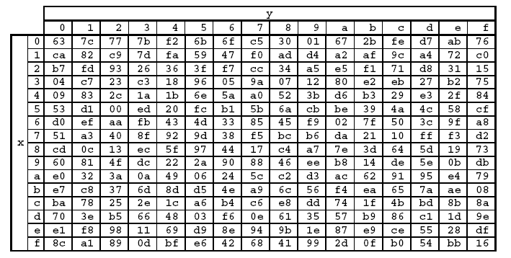
S-box Encryption Table
Use a table to do the byte substitution
Eg.

Slide 22
Side Channel Attacks: Targets Implementations
Message
E
D
Message
Communication
Channel
K_{a}
K_{b}
leaked
Information
Bob
Alice
Side Channels in the real world
Through which a cryptographic module leaks information to its environment unintentionally
Assumptions
Only Alice Knows K_{a}
Only Bob Knows K_{b}
Mallory has access to E, D and the Communication Channel
but does not know the decryption key K_{b}
Mallory

Slide 23
Side Channel Sources
Threat Model & Security Goal
Key dependent
Variations computation time
Traditionally we have handled only
Cryptographic Algorithms
Protocols
Software
Human User
Hardware
Power consumption
EM Radiations
Test Methodologies
Behavior under faults
E/D
It is impossible to design a totally secure system with humans in it
K
Deployment
& Usage
Real World System

Slide 24
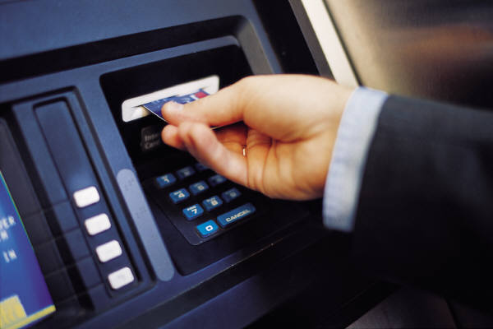
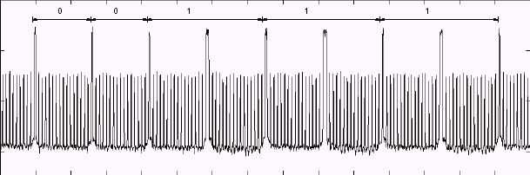
Strong cryptographic algorithms are just the beginning!
Data input
Terminal
IC chip
Data output
Power supply
00111…
Measure power consumption
Guess secret information stored on IC chip memory
Power consumption
Secret information
0
0
1
1
1
1
Notes:
With side channel attacks it is possible to break implementations of cryptosystems even though no mathematical attack is known to solve the underlying problem. With SPA, one power trace is sufficient to reveal the secret.

Slide 25
What are Side Channels?
These are covert channels which leak information which the designers of cryptographic algorithms did not consider.
Information is leaked because of the implementation:
optimization leads to information leakage
example: an if-else statement in a programming language

Slide 26
Cryptographic Implementations
Cryptography is always an overhead.
For security, the algorithms are very computation intensive.
symmetric algorithms have large number of rounds, uses non-linear Boolean functions.
asymmetric algorithms operates on large numbers, performs complex mathematical operations.
Design Challenges: Performance, Size, Power.
Further, need to tackle information leakage through covert channels: Secured Implementations.

Slide 27
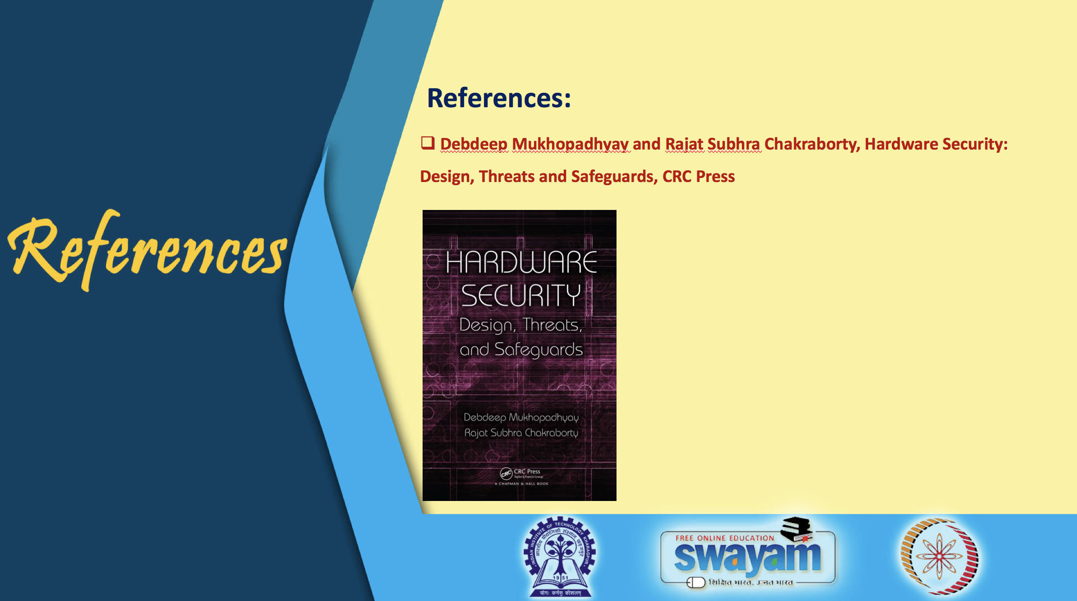

Slide 28
Conclusion:
AES is defined on binary finite fields GF(2)
AES rounds are composed of different sub-operations: AddRoundKey, Byte Substitution, ShiftRows, MixColumns.
The sub-operations are defined in the finite field GF(2).
Side Channels and Crypto-Hardware design challenges

Slide 29


